Slide 1
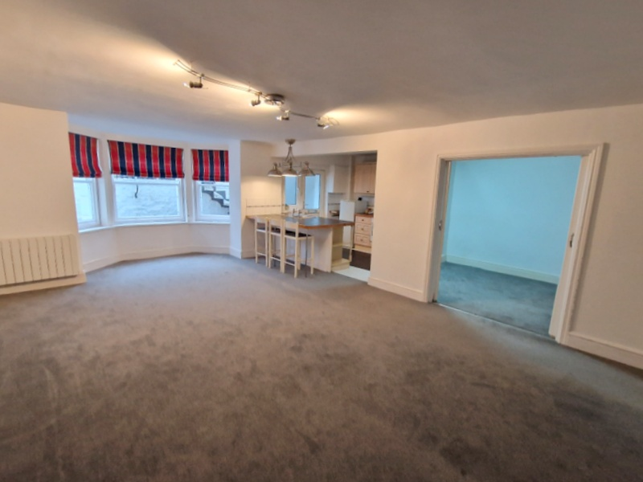
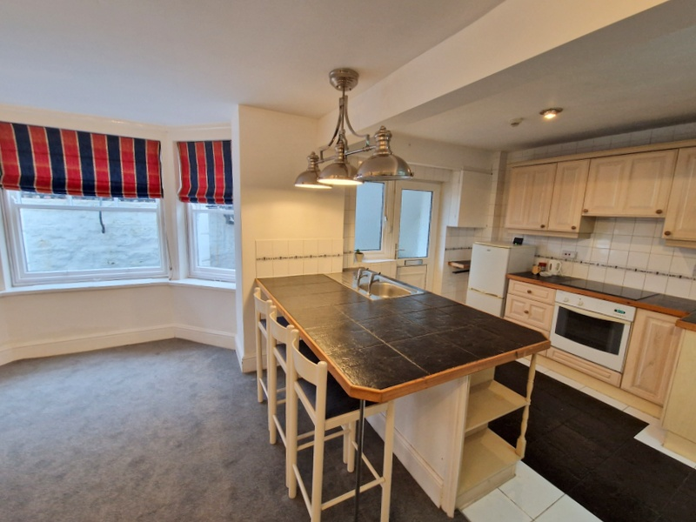
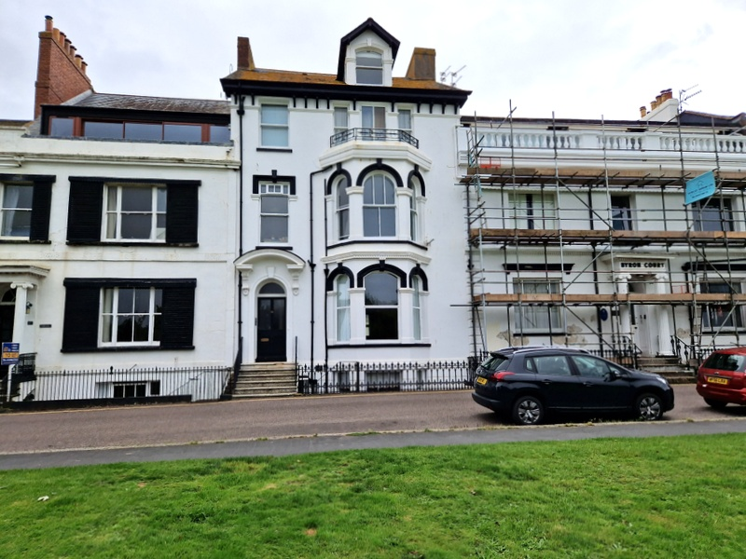
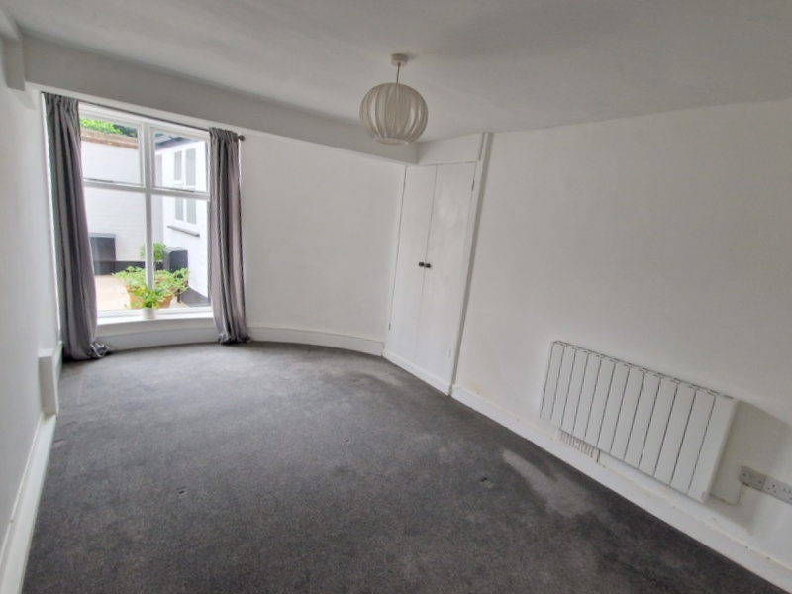
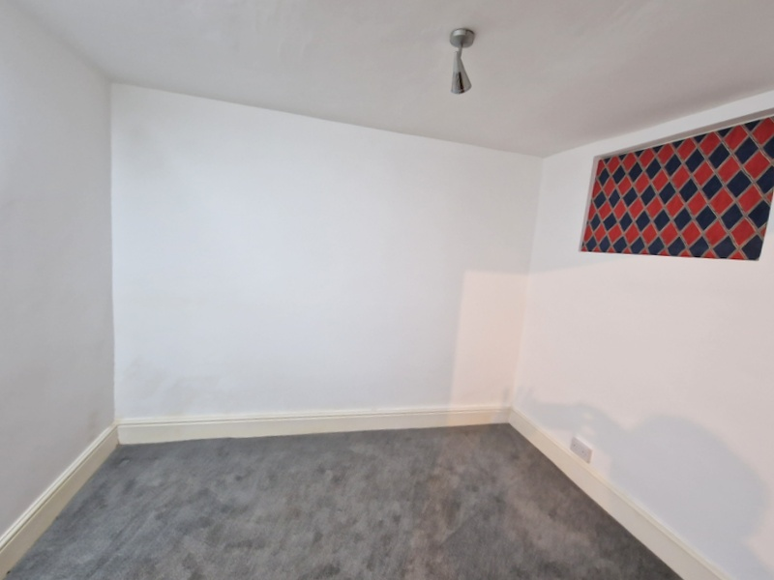
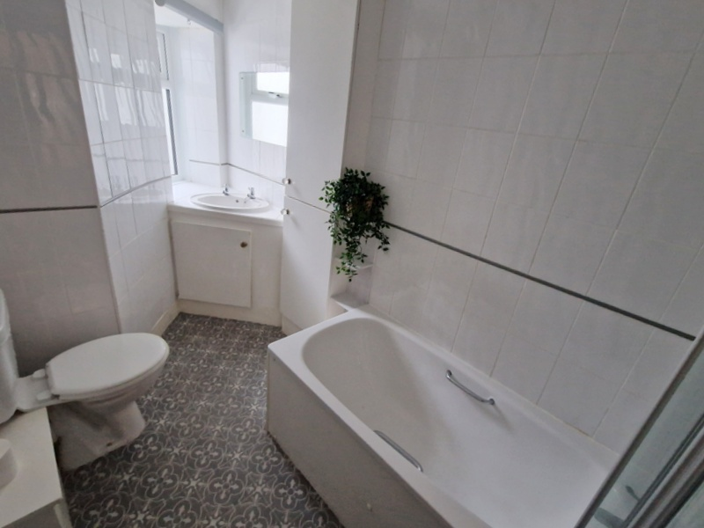
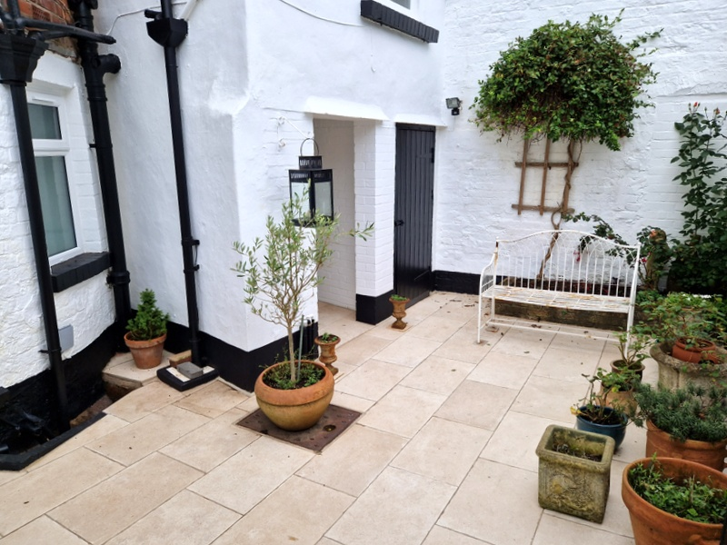
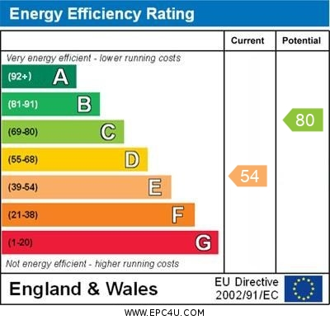
www.pennys.net
Flat 1, 18 The Beacon, Exmouth, EX8 2AF
GUIDE PRICE £235,000
TENURE Share of Freehold
A Deceptively Spacious Lower Ground Floor Garden Apartment Set In An Historic Road Close To Both Exmouth Sea Front And Town Centre
Open Plan Kitchen / Breakfast And Living Space * Double Bedroom * Hobbies Room/Occasional Bedroom * Bathroom/WC * Modern Electric Heaters * Rear Patio Communal Garden * Ideal Permanent Home Or Holiday Retreat * Long Lease * Shared Freehold * Viewing Recommended
Pennys Estate Agents Limited for themselves and for the vendor of this property whose agents they are give notice that:- (1) These particulars do not constitute any part of an offer or a contract. (2) All statements contained in these particulars are made without responsibility on the part of Pennys Estate Agents Limited. (3) None of the statements contained in these particulars are to be relied upon as a statement or representation of fact. (4) Any intending purchaser must satisfy himself/herself by inspection or otherwise as to the correctness of each of the statements contained in these particulars. (5) The vendor does not make or give and neither do Pennys Estate Agents Limited nor any person in their employment has any authority to make or give any representation or warranty whatever in relation to this property.
PENNYS ESTATE AGENTS
2 Rolle House, Rolle Street, Exmouth, Devon, EX8 2SN
Tel: 01395 264111 EMail: help@pennys.net

Slide 2
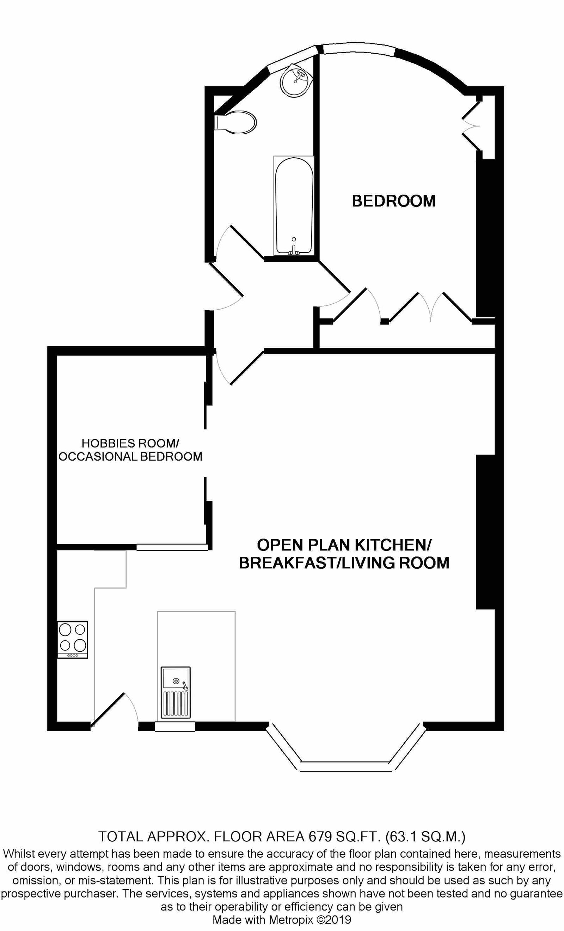
Flat 1, 18 The Beacon, Exmouth, EX8 2AF
THE ACCOMMODATION COMPRISES: From The Beacon a wrought iron staircase leads down to PRIVATE COURTYARD AREA. The property can also be accessed via the main communal front door opening to the impressive communal hallway with stairs leading to the flats own private front door with patterned glass window inset giving access to:
OPEN PLAN KITCHEN / BREAKFAST / LIVING ROOM: A most spacious room divided into designated areas comprising of:
KITCHEN/BREAKFAST AREA: 11' 0" (3.35m) x 9' 0" (2.74m) With tiled work top surfaces extended to provide a breakfast bar area with down lighters over; range of base cupboards, drawer units, space and plumbing for washing machine and built-in oven beneath work surfaces; inset single drainer sink unit; inset four ring electric hob with extractor hood over; matching wall units at eye-level with concealed lighting beneath; extensively tiled walls and colour coordinated tiled flooring; space for upright fridge/freezer; double glazed window with patterned glass next to front door. Opening through to:
LIVING AREA: 23' 8" (7.21m) x 15' 5" (4.7m) maximum measurement into wall recesses and secondary glazed bay window overlooking the front aspect and fitted with three sash windows. A most spacious room with two modern electric heaters; ceiling spotlighting; television point; sliding glazed double doors opening to:
HOBBIES ROOM/OCCASIONAL BEDROOM: 10' 3" x 8' 5" (3.12m x 2.57m) A versatile room with picture glazed window overlooking the kitchen area; internal window with patterned glass; glazed door opening to:
RECEPTION HALL: With door giving access to communal areas; ceiling spotlighting.
BEDROOM: 15' 4" (4.67m) x 9' 5" (2.87m) A charming bedroom with good size window overlooking the rear communal garden; range of built-in wardrobes with clothes rail and shelving; adjoining airing cupboard with water tank and timer control for hot water, modern electric heater.
BATHROOM/WC: Comprising of a bath with shower attachment; shower splash screen; wash hand basin set in tiled display surface with cupboard beneath; WC with dual pushbutton flush; electric heated towel rail; fully tiled walls; shallow upright medicine cabinet; double glazed window with patterned glass.
OUTSIDE: Directly to the front of the property is a private small garden enclosure. To rear there is an enclosed communal cottage style patio garden where Flat 1 has the benefit of its own good size garden storage. From the communal garden a wrought iron gate gives access to a pathway of which the flat has right of way which in turn leads to the rear of The Beacon.
TENURE AND OUTGOINGS: The property has the benefit of owning a one fifth (1/5) share of the freehold. We understand the property is held on a 999 year lease.
Mortgage Assistance: We are pleased to recommend Meredith Morgan Taylor, who would be pleased to help no matter which estate agent you finally buy through. For a free initial chat please contact us on 01395 264111 to arrange an appointment. Your home may be repossessed if you do not keep up repayments on your mortgage. Meredith Morgan Taylor Ltd is an appointed representative of Openwork Limited, a trading style of Openwork Ltd which is authorised and regulated by the Financial Conduct Authority (FCA).
FLOOR PLAN:

